Slide 1

House Price Prediction in Natural Hazard Prone Areas
Uma Maheswari Raju

Slide 2



Who is the audience?
Banks and Financial Investors
Real estate company and marketplace

Slide 3
Data Collection
Zillow Properties Data (San Jose)
https://www.zillow.com/homes/san-jose_rb/
Natural Hazard Data
Seismic Hazard Data
https://spatialservices.conservation.ca.gov/arcgis/rest/services/CGS_Earthquake_Hazard_Zones/SHP_ZoneInfo/MapServer
Fire Hazard Data
http://www.fire.ca.gov/fire_prevention/fhsz_maps/FHSZ/santa_clara/San_Jose.pdf

Slide 4
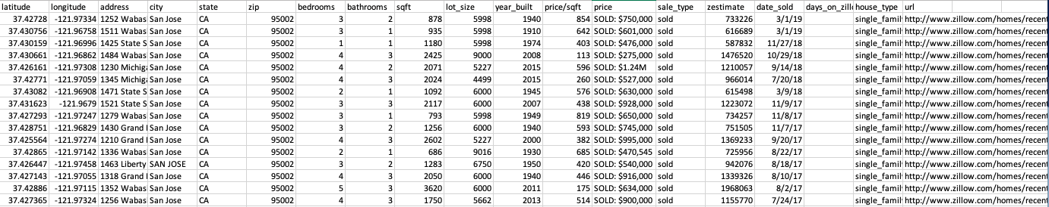
Data Collection – House Data
Web scraping was done to access Zillow property data using python and web scraping packages such as selenium and BeautifulSoup

Slide 5
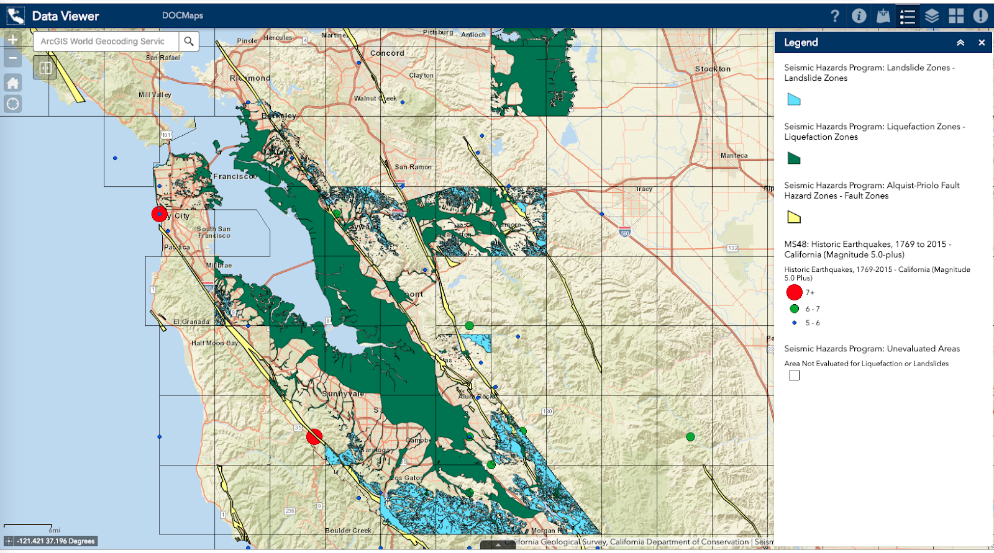
Data Collection – Seismic Hazard
Source: California Geological Survey (CGS)

Slide 6
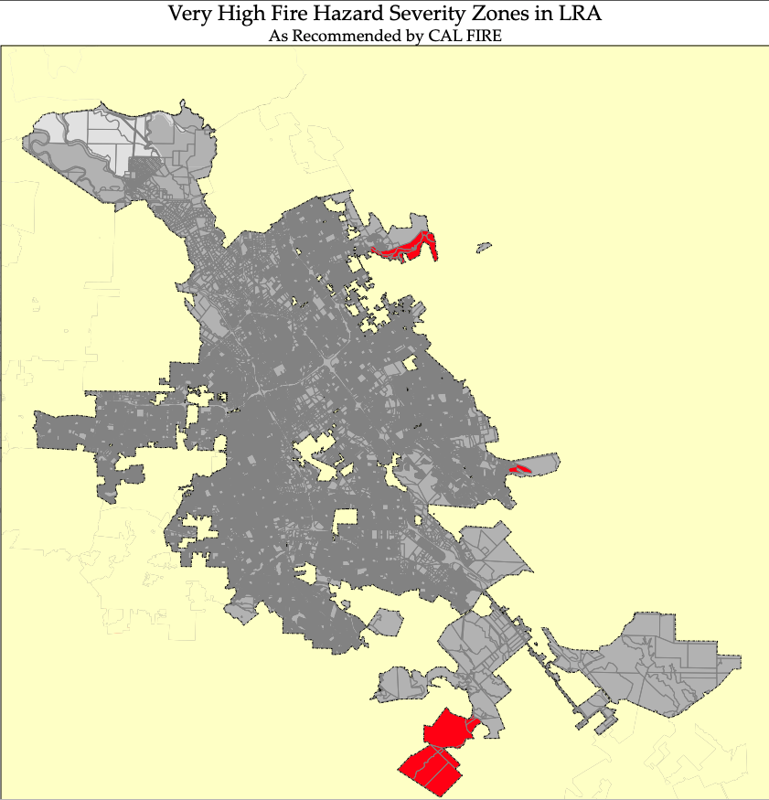
Data Collection – Fire Hazard
Source: CALFIRE

Slide 7
Data Wrangling
San Jose City, California
House sold between 2016-2019
13993 observations and 7 features
All data frames were merged and duplicates were removed
Different formats were corrected
Error data were corrected
Data types were corrected
Missing data and outliers were handled

Slide 8
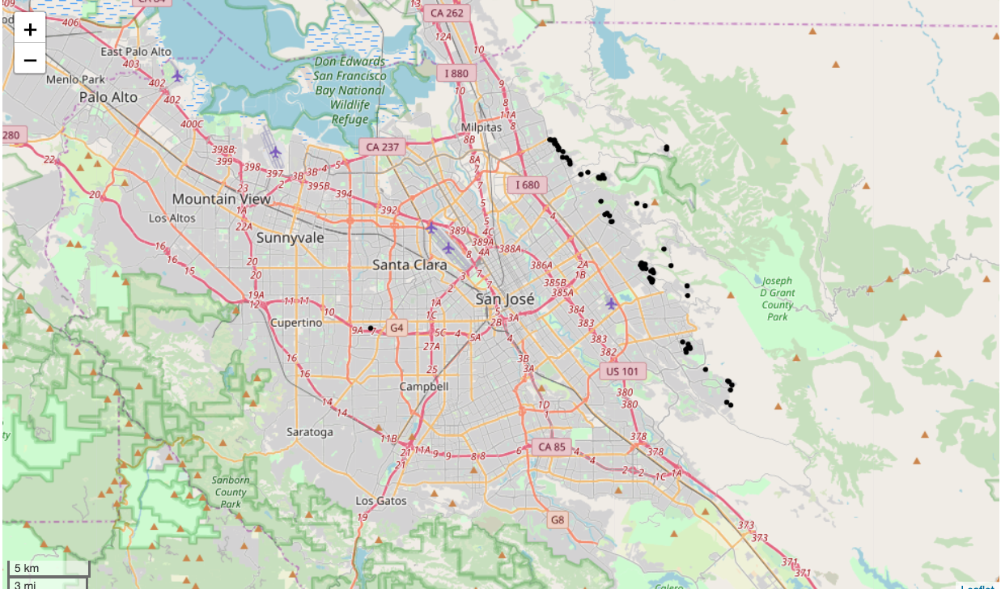
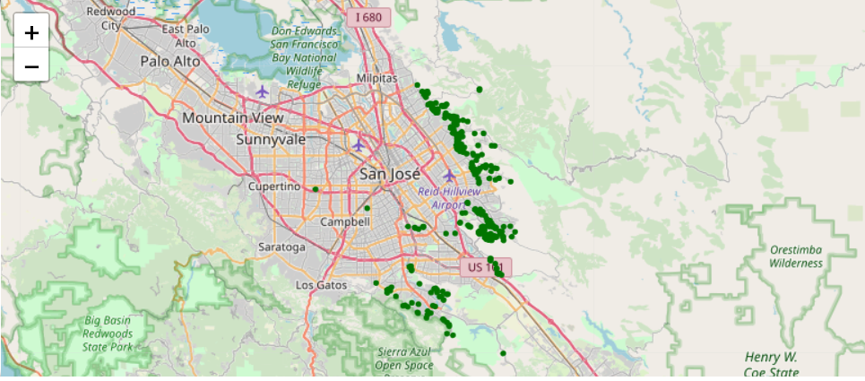
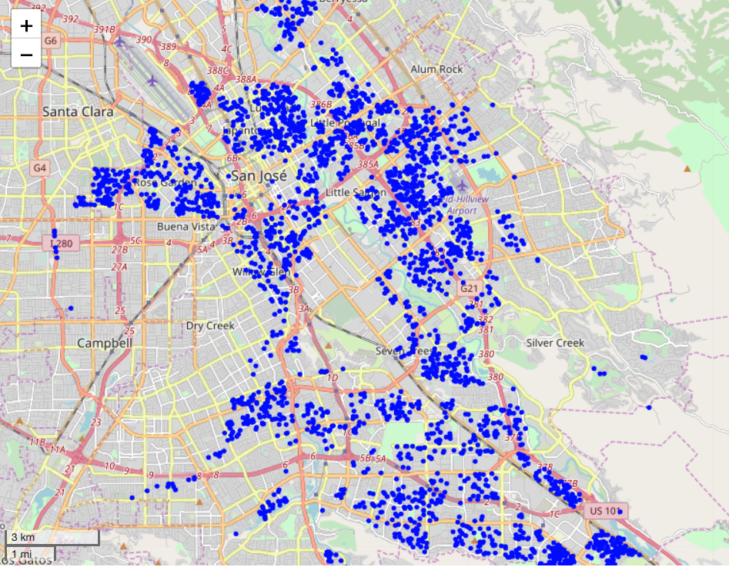
Exploratory Data Analysis (EDA)
Where are hazards prone areas? Which hazard is the most common and least common in city? How are they distributed in the city?
Fault zone
Landslide
Liquefaction

Slide 9
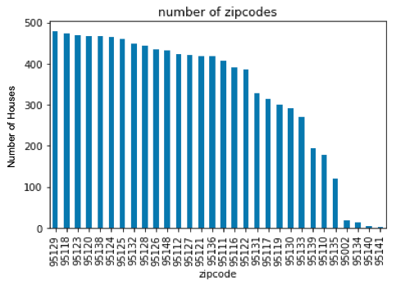
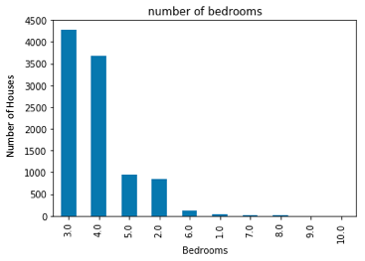
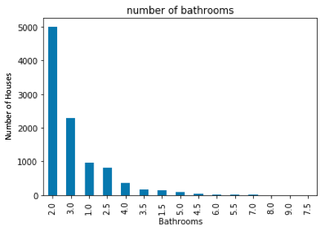
EDA
Popular homes among buyers

Slide 10
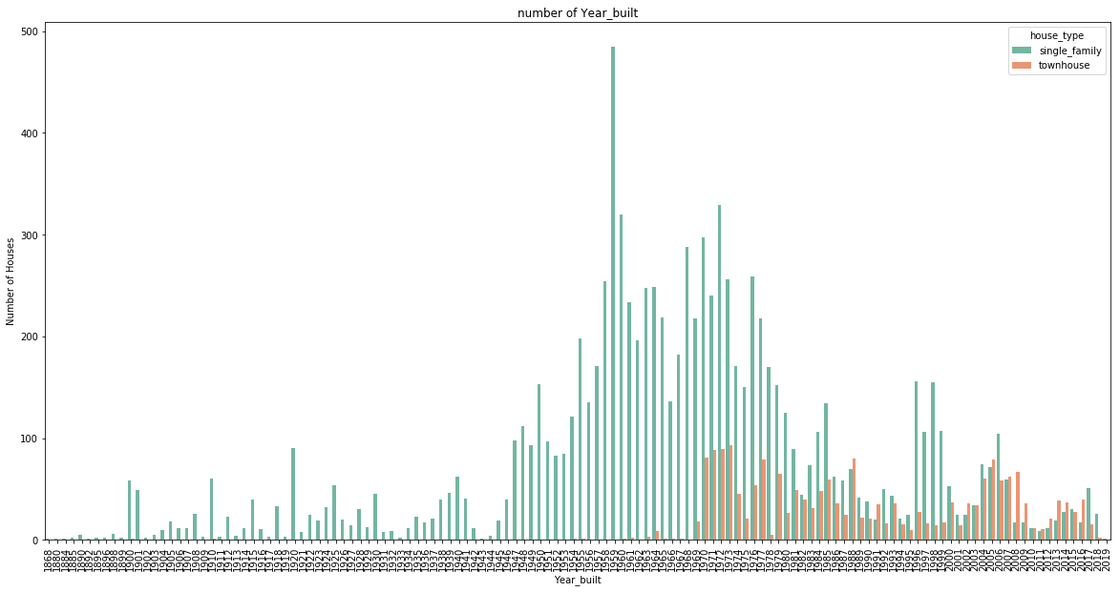
EDA
Which year built is the most common ?

Slide 11
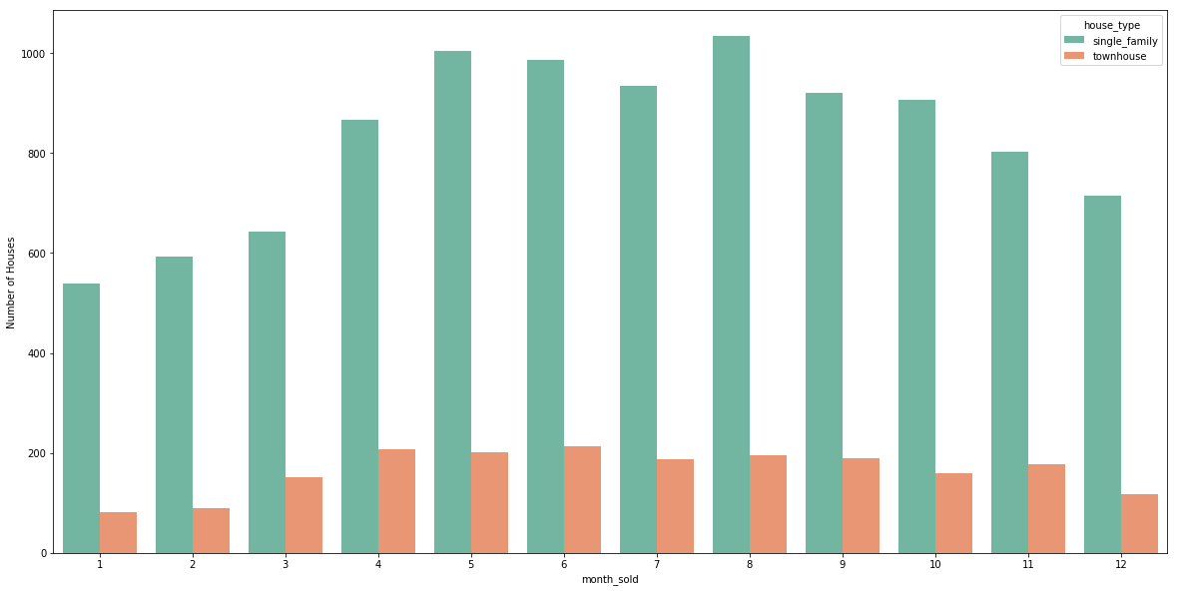
EDA
Which month is popular for selling house?

Slide 12
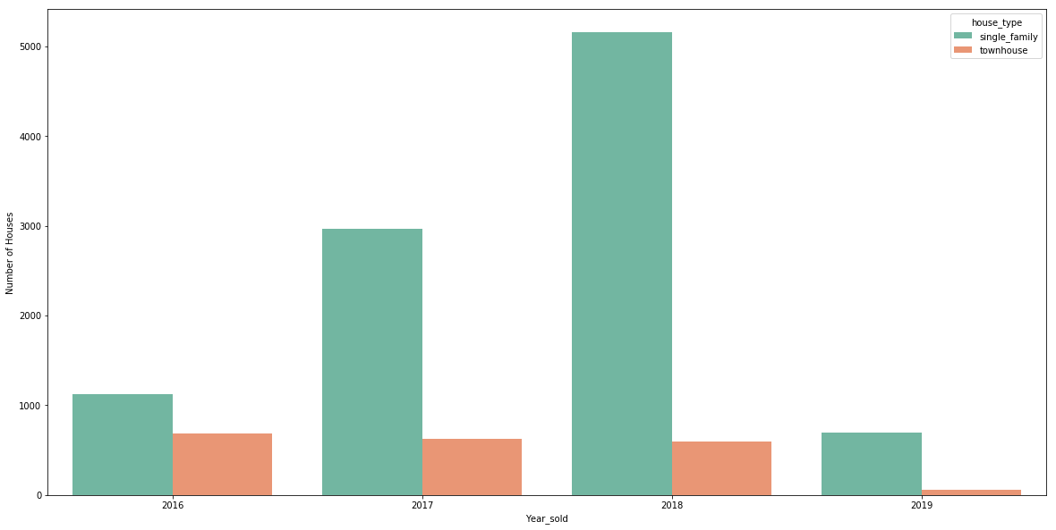
EDA
Which year was most house sold?

Slide 13
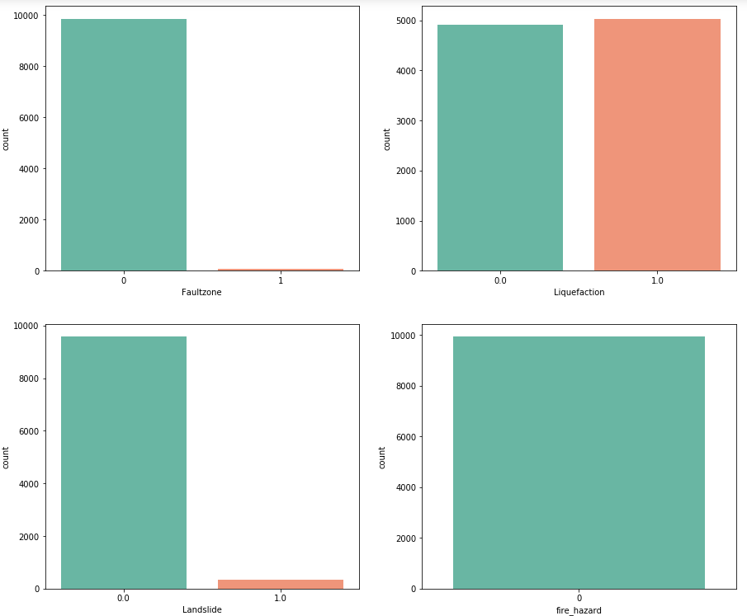
EDA
Which hazard is most common?

Slide 14
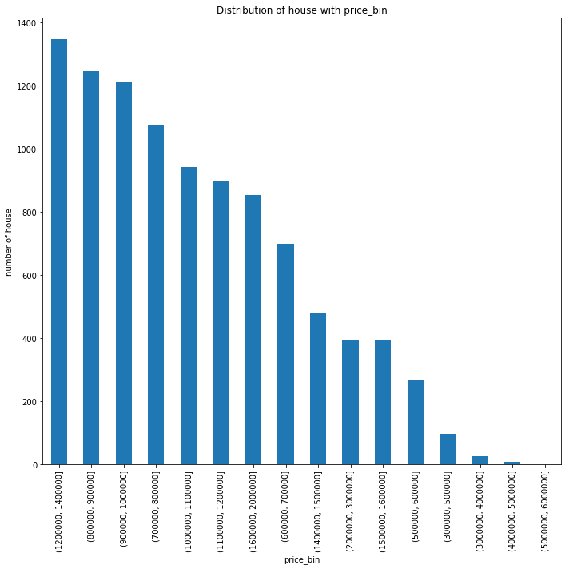
EDA
How many number of houses in different price bin?

Slide 15
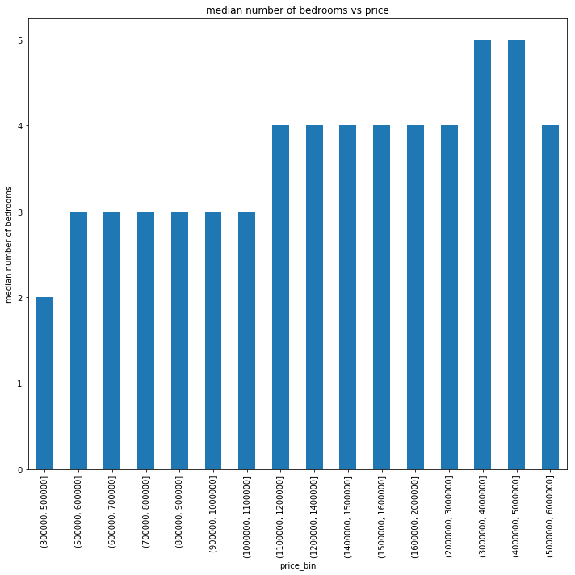
EDA
How many number of bedrooms in different price bin?

Slide 16
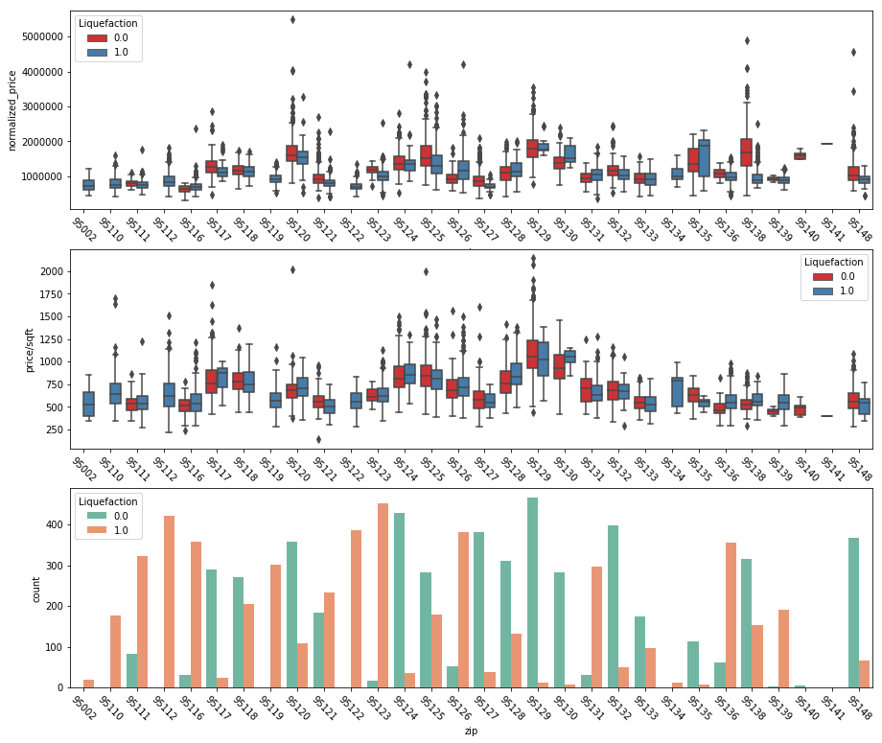
EDA
What is the effect of natural hazard (Liquefaction) in price?

Slide 17
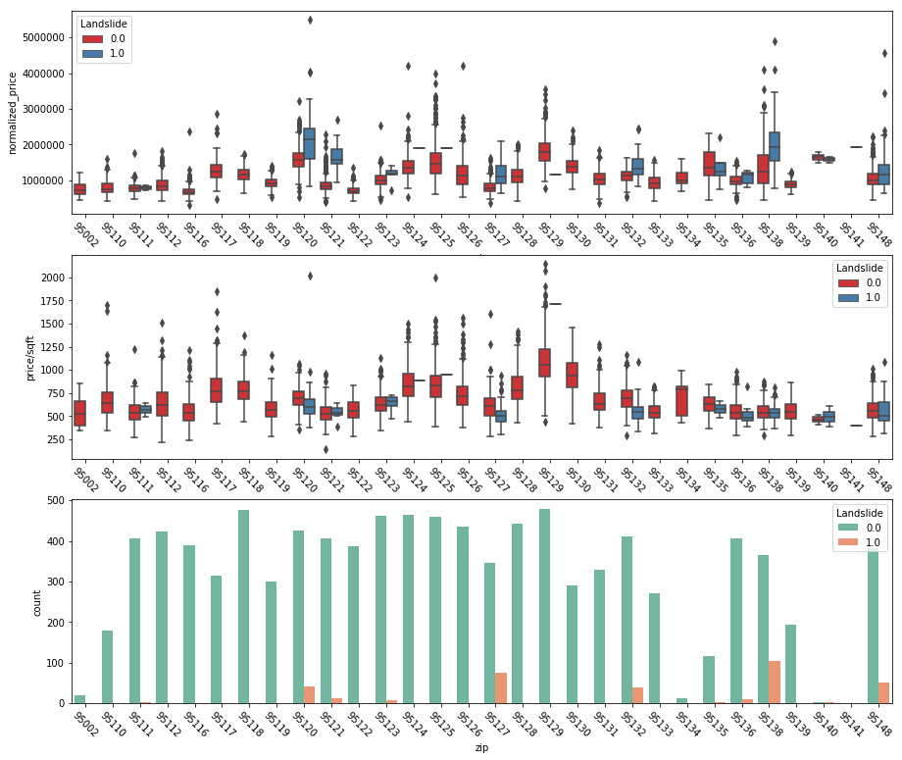
EDA
What is the effect of natural hazard (Landslide) in price?

Slide 18
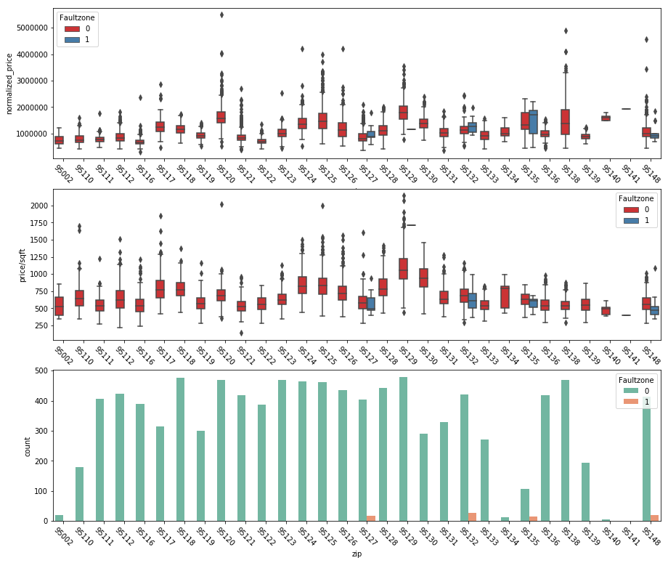
EDA
What is the effect of natural hazard (Fault zone) in price?

Slide 19
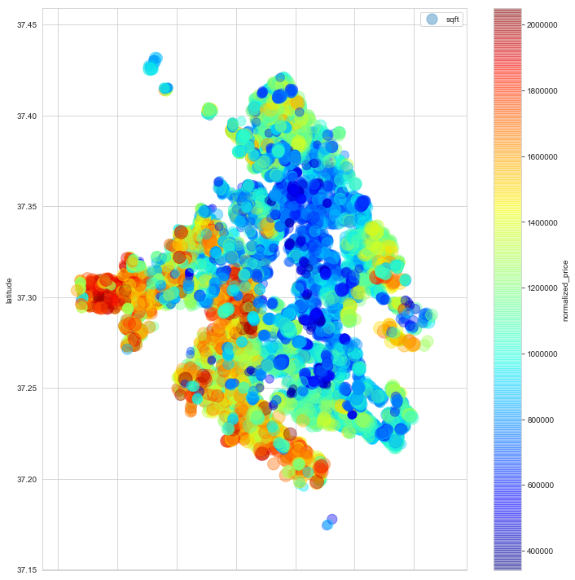
EDA
Price distribution in geospatial frame

Slide 20
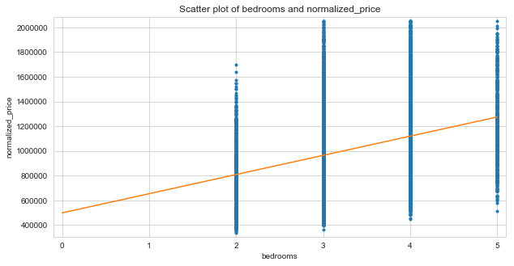
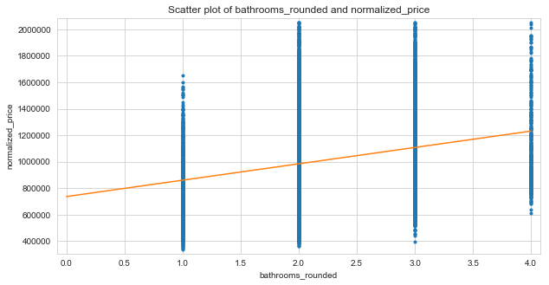
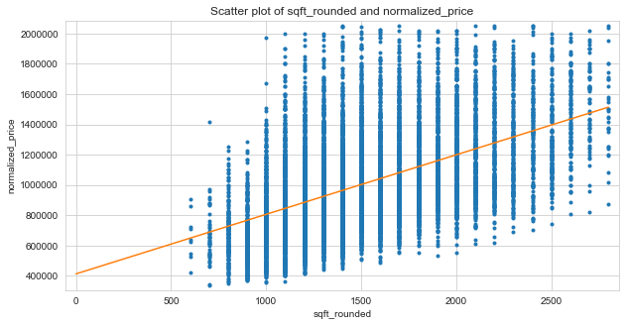
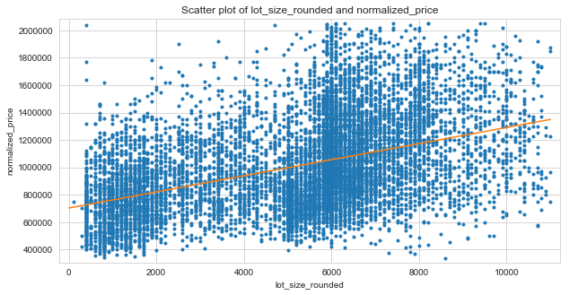
Correlation - Features and Price

Slide 21
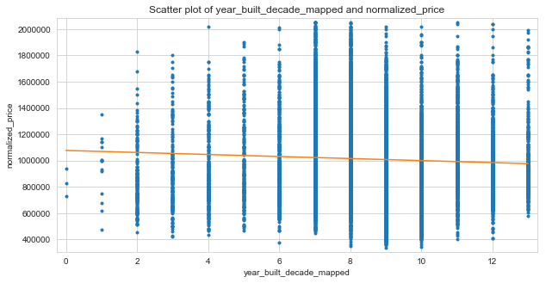
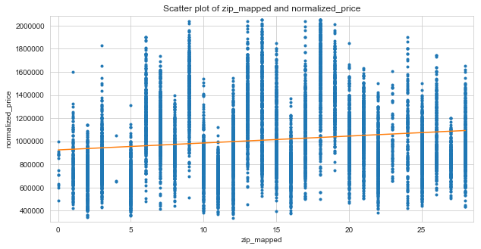
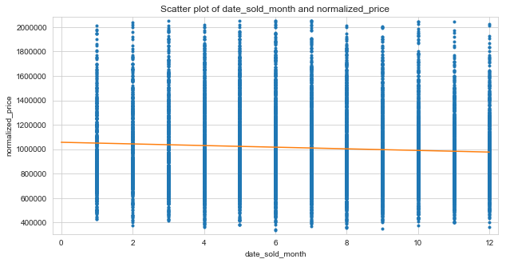
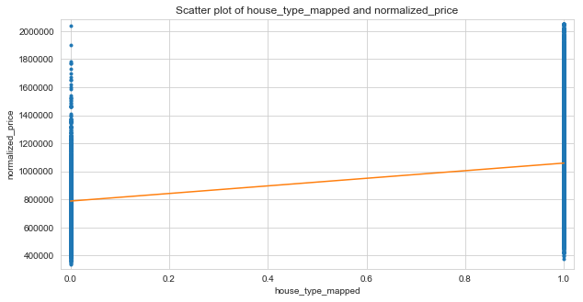
Correlation - Features and Price

Slide 22
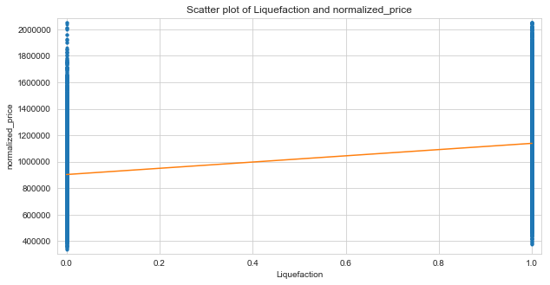
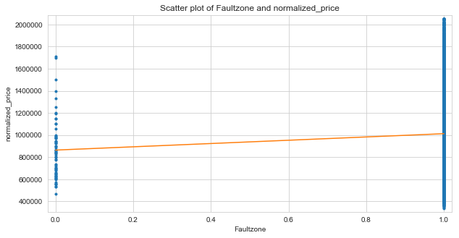

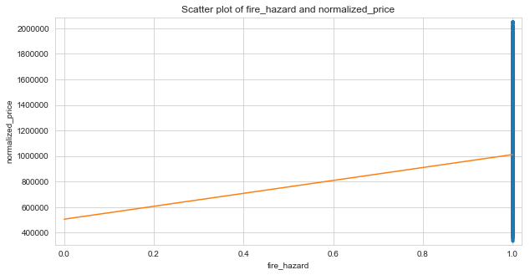
Correlation - Features and Price

Slide 23
Correlation Coefficients
Sqft 0.521310
Lot size 0.428212
Bedrooms 0.368206
Liquefaction 0.361638
House type 0.317384
Bathrooms 0.250558
Zip code 0.139833
Fault zone 0.036062
Month_sold -0.065022
Year built -0.052772
Landslide -0.002046
Fire hazard NaN

Slide 24
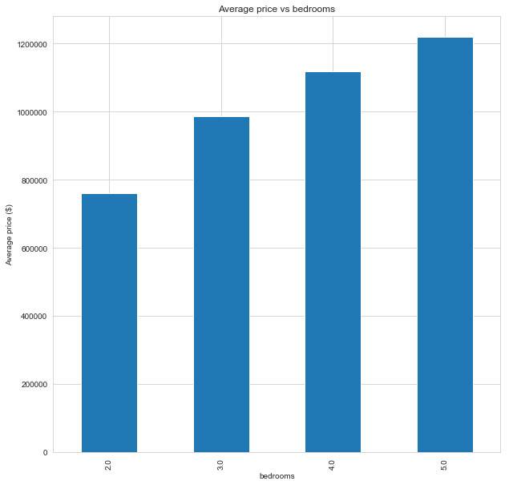
Data Story

Slide 25
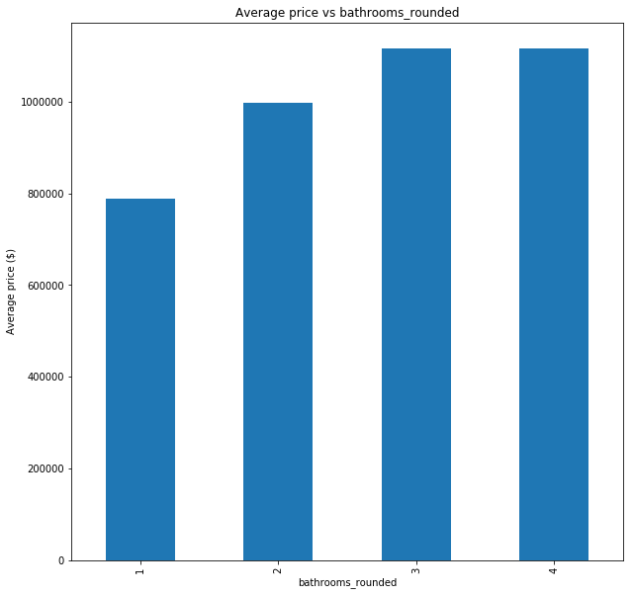
Data Story

Slide 26
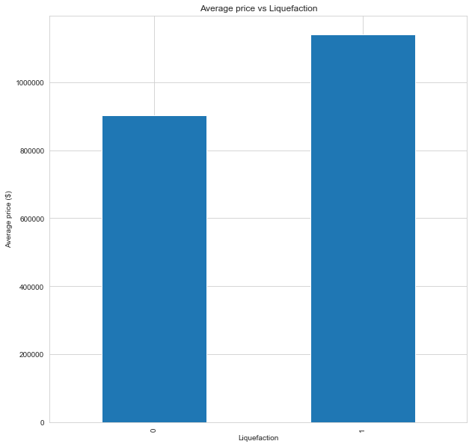
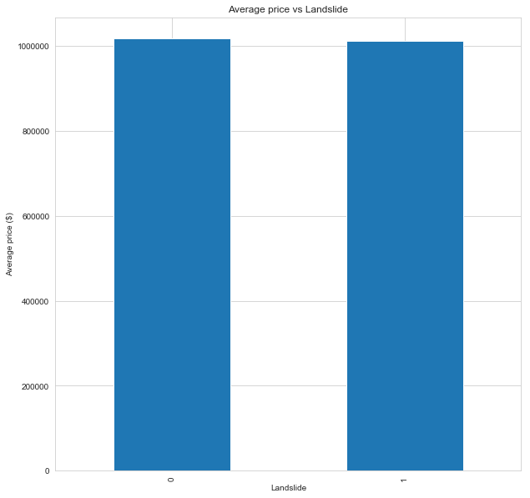
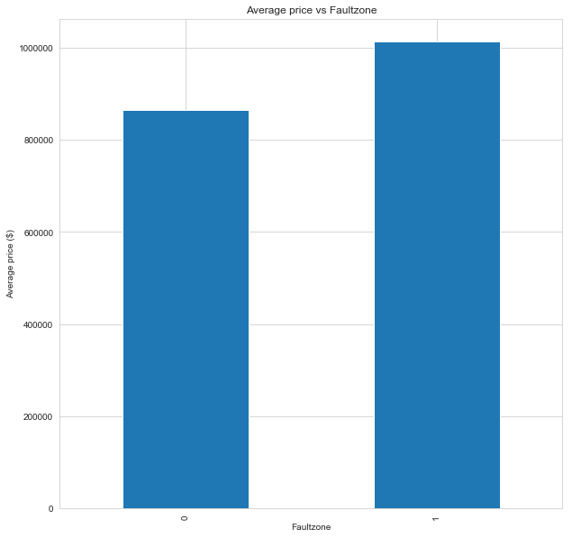
Data Story
Liquefaction
Landslide
Fault zone

Slide 27
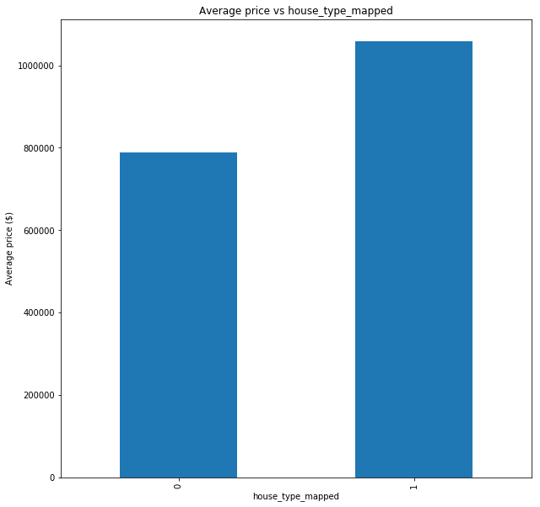
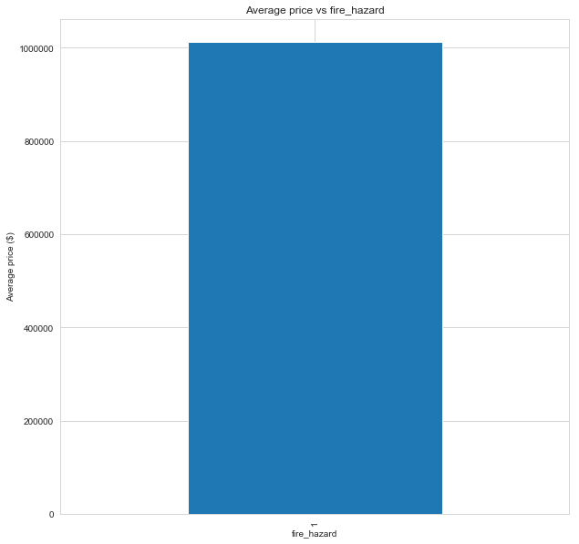
Data Story
Fire hazard

Slide 28
Inferential Statistics
H0: There is no significant correlation between features and price
Ha: There is a correlation between features and price
The.
Features bedrooms, bathrooms, sqft, lot size, liquefaction, fault zone, house type, and zip code, p value is less than level of significance 0.05 which suggested significant correlation between above features and price.
Other features such as year built, month sold and landslide, p value was greater than 0.05 which suggested no significant correlation between those features and price.

Slide 29
Machine Learning Models
Linear Regression
Decision Tree Regressor
Gradient Boosting Regressor
Random Forest Regressor

Slide 30
Metrics
Mean Squared Error (MSE)
Root Mean Squared Error (RMSE)
R2_score
Mean Absolute Error (MAE)
Mean Absolute Percent Error (MAPE)

Slide 31
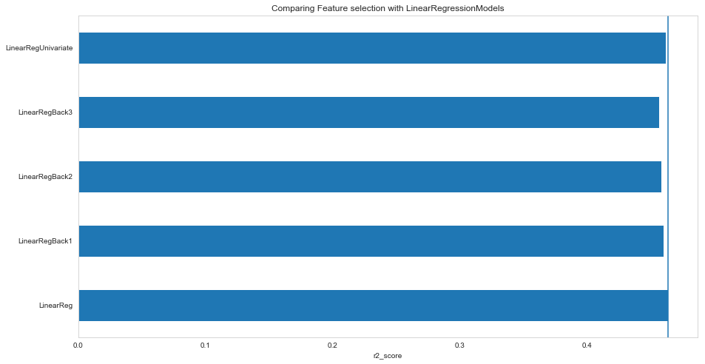
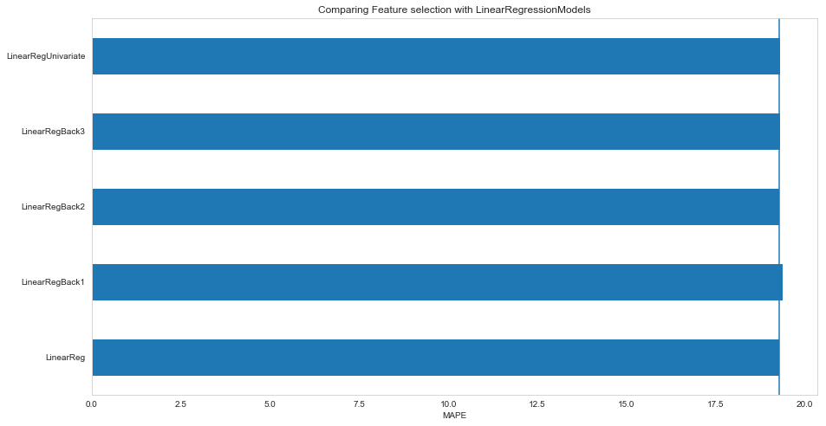
Feature Selection
Backward Elimination
Univariate Elimination

Slide 32
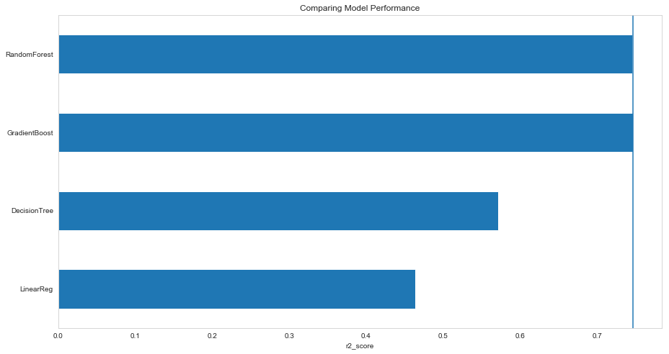
Comparison of Regressor Models

Slide 33
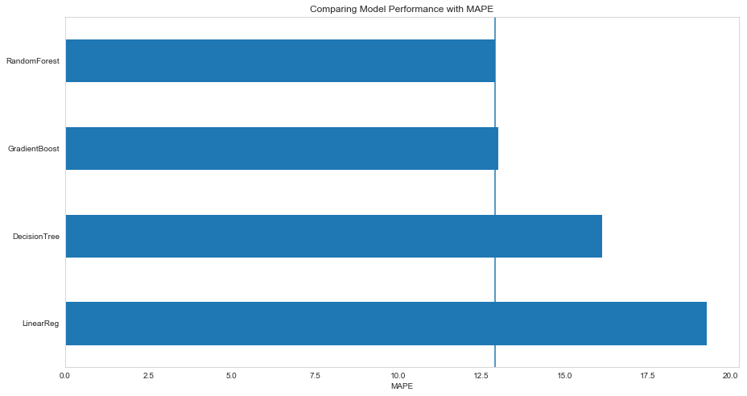
Comparison of Regressor Models

Slide 34
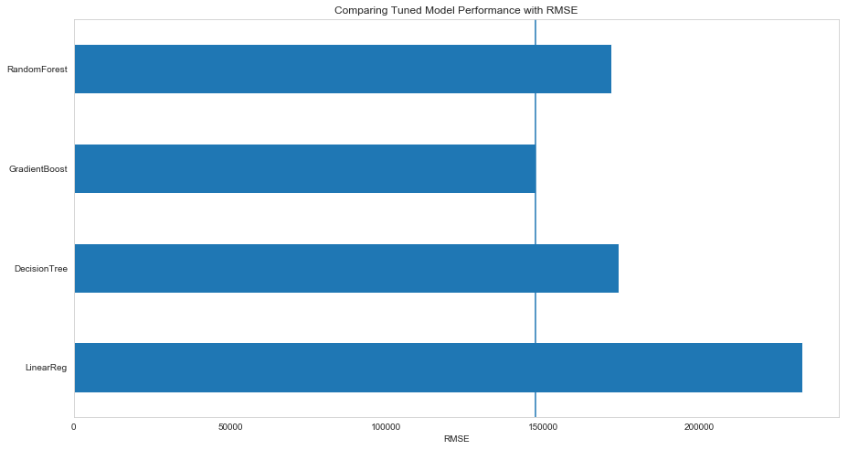
Hyperparameter Tuned Model Performance
GridSearchCV
RandomizedSearchCV

Slide 35
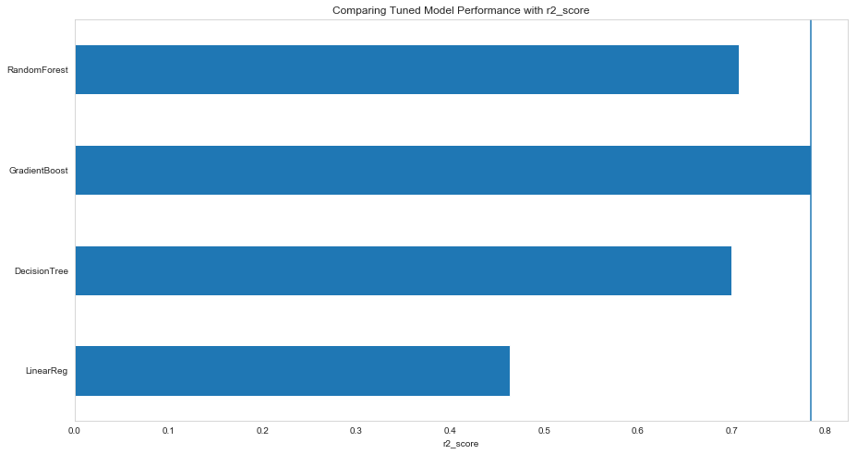
Hyperparameter Tuned Model Performance

Slide 36
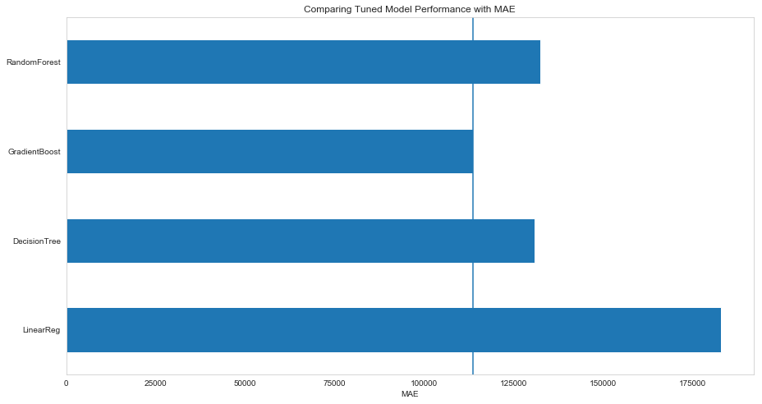
Hyperparameter Tuned Model Performance

Slide 37
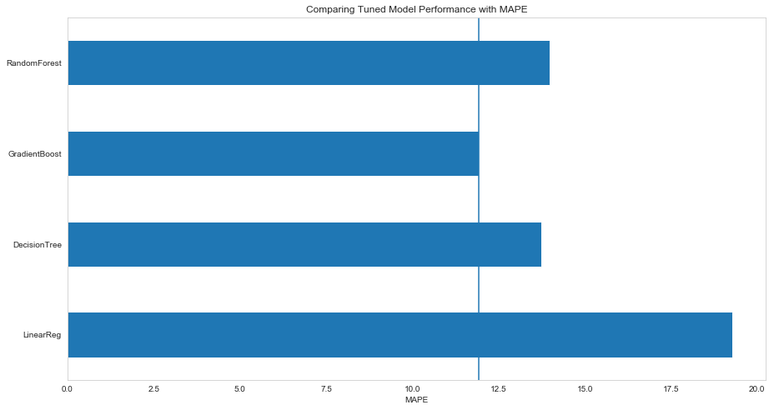
Hyperparameter Tuned Model Performance

Slide 38
Conclusion
The Gradient boosting regressor model was better than random guess and it was better performing model compared to other 3 models.
Many other regression models which were not included in this project can be built for house price prediction.

Slide 39
Appendix
Zip codes | Neighborhood
95120 | Alameden valley
95127 | Alum rock
95002 | Alviso
95123,95136 | Blossom valley
95128 | Burbank
95112 | Chinatown
95110,95112,95113 | Downtown
95127 | East foothills
95111,95123,95136 | Edenvale
95148,95121,95138 | Evergreen
95112 | Japantown
95126 | Midtown,Rosegarden
95119,95138,95139,95193,95123 | Santa Teresa
95111 | Seven trees
95138 | Silver creek valley
95113 | SOFA district
95111,95119,95120,95123,95136,95138,95139,95193 | South San Jose

